Slide 1
Introduction to Deep Learning
Optimization Methods
1

Slide 2
Optimization Methods for Training a Deep Neural Network
Slow convergence of gradient descent method
Problem addressed: How to reduce the number of epochs taken to reach a local minimum?
Weight update methods that use the past history of updates have been shown to be effective.
•
•
Generalized delta rule that uses momentum factor
Weight-specific learning rate scheduling methods (Adaptive learning rate methods)
AdaGrad
RMSProp
AdaDelta
AdaM
Second-order methods for optimization
•

Slide 3
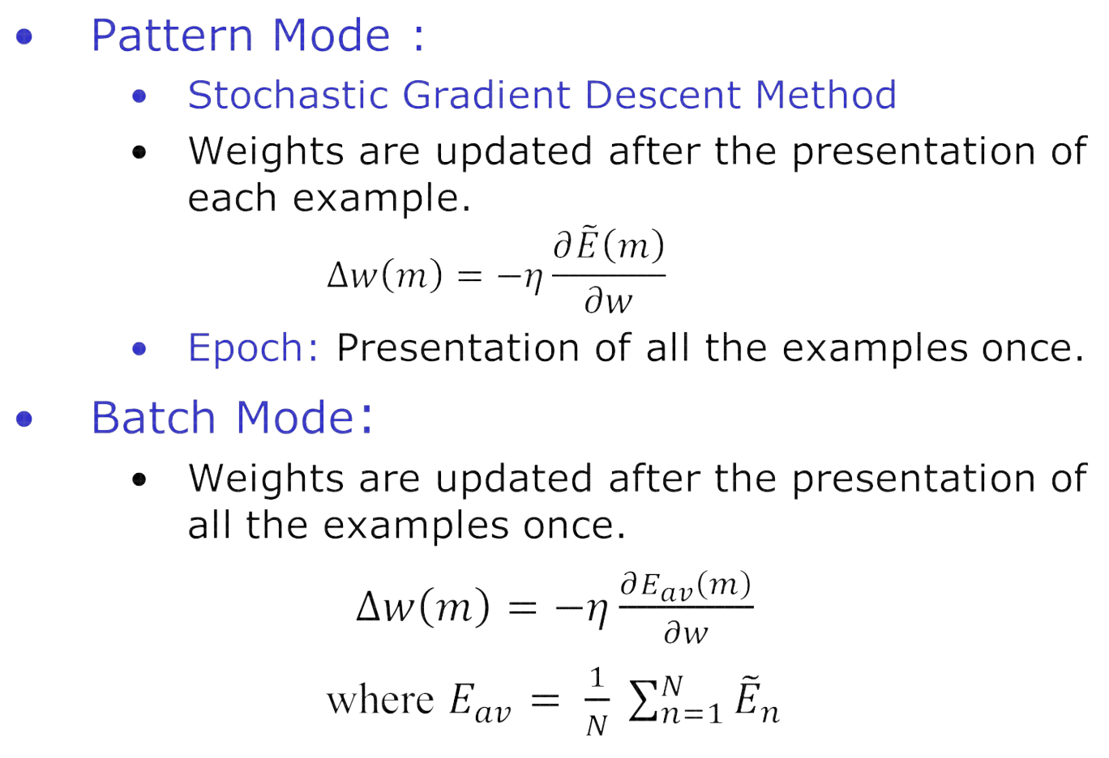
Gradient Descent Method

Slide 4
Weight Update Rules
Weight update at step m:
𝑤_{𝑚+1} = 𝑤_{𝑚} + ∆𝑤 𝑚
Delta Rule:
𝜕𝐸
∆𝑤 𝑚 = −𝜂
𝜕𝑤(𝑚)
η is the learning rate parameter in the range 0.0 to 1.0
E is the error function
Generalized Delta Rule:
𝜕𝐸
∆𝑤 𝑚 = −𝜂 + 𝛼∆𝑤 𝑚 − 1
𝜕𝑤 𝑚
𝛼 is the momentum factor in the range 0.0 to 1.0

Slide 5

Generalized Delta Rule
𝜕𝐸
∆𝑤 𝑚
= −𝜂
+ 𝛼∆𝑤 𝑚 − 1
𝜕𝑤 𝑚
∆𝑤 𝑚
= −𝜂𝑔 𝑚
+ 𝛼∆𝑤 𝑚 − 1
Low Curvature Region
𝑤 1 = 𝑤 0
− 𝜂𝑔 0
𝑤 2 = 𝑤 1
− 𝜂𝑔 1
+ 𝛼∆𝑤 0
High Curvature
Region
𝑤 3 = 𝑤 2
− 𝜂𝑔 2
+ 𝛼∆𝑤 1
𝑤 𝑚 + 1 = 𝑤 𝑚 − 𝜂𝑔 𝑚 − 𝜂 𝛼𝑔 𝑚 − 1
− 𝜂 𝛼²𝑔 𝑚 − 1 − …. −𝜂 𝛼^{𝑚}𝑔 0
Low curvature region of error surface: Change in gradient is very small.
𝑤 𝑚 + 1
= 𝑤 𝑚
= 𝑤 𝑚 −
= 𝑤 𝑚
− 𝜂 1 + 𝛼 + 𝛼² + ⋯ + 𝛼^{𝑚} 𝑔
𝜂
𝑔
1−𝛼
− $\hat{η}$𝑔
𝜂 is the effective learning rate. For 𝛼 = 0.9, $\hat{η}$= 10𝜂
5

Slide 6
Adaptive Learning Rate Methods
AdaGrad:
𝜂
= − _{𝜀 + 𝑟 𝑚} 𝑔 𝑚
∆𝑤 𝑚
_{𝑟}2
𝑚 = 𝑔² 0 + 𝑔² 1 + 𝑔²
2 + … + 𝑔² 𝑚 − 1
ε is a small positive constant
RMSProp:
𝜂
⁼ ⁻ 𝜀 + 𝑟 𝑚 ^{𝑔 𝑚}
∆𝑤 𝑚
𝐿
1
= 𝜌 𝑔² 𝑚 − 𝑙 + 1 − 𝜌 𝑔² 𝑚
𝑟 ² 𝑚
𝐿
𝑙=1
Moving average of past gradients
ρ is the weightage given to the average of the past L gradients

Slide 7
Adaptive Learning Rate Methods
AdaDelta:
𝑝 𝑚
⁼ ⁻ 𝜀 + 𝑟 𝑚 ^{𝑔 𝑚}
∆𝑤 𝑚
𝐿
1
𝑚 = 𝛾 Δ𝑤²
_{𝑝}2
𝑚 − 𝑙 − 1
+ 1 − 𝛾 Δ𝑤²
𝑚 − 1
𝐿
𝑙=1
Moving average of past changes in weight
γ is the weightage given to the average of the past L changes in weight
Learning rate is not used in the AdaDelta method as it is implicitly present in the past change in the weight.

Slide 8
Adaptive Learning Rate Methods
Adaptive Moments (AdaM):
It uses the first moment and the second moment of gradient
More effective than Generalized Delta rule, AdaGrad, RMSProp and
AdaDelta
𝑞 𝑚
^{= −𝜂} 𝜀 + 𝑠 𝑚
∆𝑤 𝑚
𝑔 𝑚
𝑞 𝑚 = 1 − 𝜌₁ 𝑞 𝑚 − 1 + 𝜌₁𝑔 𝑚
𝑠 𝑚 =
1 − 𝜌₂ 𝑠 𝑚 − 1 + 𝜌₂𝑔² 𝑚
𝜌₁is the weightage given to the first moment of the current gradient
𝜌₂is the weightage given to the second moment of the current gradient
𝑞 𝑚 : Exponentially weighted moving average of the first moment
𝑠 𝑚 : Exponentially weighted moving average of the second moment ⁸

Slide 9
Second Order Methods
The second order methods make use of the second order derivatives of error function with weight parameters
Newton’s method of approximation:
Let 𝑤 be the vector of all weight parameters in the model
Let 𝑔 be the vector of the first derivative of the error function with all
weight parameters in the model
Let H be the Hessian matrix. The element ℎ_{𝑖𝑗} of H is the second derivative
of the error function E with ith and jth weight parameters.
Second order approximation of error function:
𝐸 𝑤 + 𝛥𝑤
= 𝐸 𝑤 + 𝑔 ^{𝑡}𝛥𝑤 + 𝛥𝑤^{𝑡}𝐻𝛥𝑤
Optimal change in 𝑤 is given by
Δ𝑤∗ = − 𝐻⁻¹𝑔

Slide 10
Second Order Methods
Levenberg-Marquardt (LM) Method
Suitable for batch mode of learning only
It approximates the Hessian matrix by an outer- product matrix, and reduces the computational complexity
Broyden-Fletcher-Goldfarb-Shanno (BFGS) Method
It approximates the inverse of Hessian matrix
Conjugate-Gradient Method

